Slide 1


Slide 2

Department of Computer Science and Engineering
Advanced Techniques in Deep Learning for Pancreatic Cancer Detection and Classification
PRESENTED BY
Gandikota Narendra (21471A05M4)
Katta Subbarao (21471A05P0)
Nallabothu Narendra (21471A05P7)
Under the Guidance of,
K.V.Narasimha Reddy _{BTech,MTech},
Assistant Professor,
Department of Computer Science and Engineering,
Narasaraopeta Engineering College (Autonomous),
Narasaraopet- 522 601.

Slide 3
OUTLINE
Abstract
Introduction
Literature Survey
Research Gaps
Problem Statement
Objectives
Block Diagram / Flow Diagram
Methodology
Results and Analysis
Conclusion & Future Scope
References
Question and Answers
Acknowledgements

Slide 4
ABSTRACT
This project introduces InceptionDense, a hybrid deep learning model for pancreatic cancer detection and classification using an annotated CT image dataset. Preprocessing steps included resizing, normalization, and label encoding, along with data augmentation for improved generalization. InceptionDense combines InceptionV3 and DenseNet121 for multi-scale feature extraction and dense connectivity, with hyperparameter tuning performed using the Adam optimizer. The model achieved remarkable metrics: 99.75% accuracy, 99.47% precision, and 100% recall. This innovative approach enhances diagnostic reliability, aiding in early detection and improved patient outcomes.

Slide 5
INTRODUCTION
Introduction : Pancreatic cancer is a highly lethal disease often detected at advanced stages due to inadequate screening tools. This project introduces InceptionDense, a hybrid deep learning model combining InceptionV3 and DenseNet121 to enhance diagnostic accuracy through multi-scale feature extraction and efficient feature reuse.
Motivation : High mortality rates demand better diagnostic tools. Early detection improves patient survival and treatment outcomes. Deep learning advances enable automated, accurate image analysis.
Importance and relevance : Provides early-stage detection solutions. Reduces diagnostic errors and supports clinicians.

Slide 6
LITERATURE SURVEY
No | Title | Author | Journal Name & Year | Methodology Adapted | Key Findings | Gaps
1 | SSA With Stacked DL Based Medical Image Analysis for Pancreatic Cancer Detection and Classification | Janjhyam Venkata Naga Ramesh et al. | IEEE & 2023 | Utilizes DenseNet for preprocessing, SSA for feature extraction, and CNN-BiLSTM for classification. | The SSASDL-PCDC technique demonstrated high performance with a max sensitivity, specificity, and accuracy of 99.26%. | Future work aims to extend the model to other medical images and explore real-time applications.
2 | Advancing PM: VAE Enhanced Predictions of PC Patient Survival in Local Hospital | Yuan Wang; Chenbi Li; Zeheng Wang | IEEE & 2024 | Employs Variational Autoencoders (VAE) for data augmentation and uses Elastic Net, Decision Trees, and RBF-SVM for survival prediction. | VAE-assisted ensemble learning strategy accurately predicts in-hospital clinical outcomes | Future work will focus on multi-center data integration, expanding patient stages, and adding more variables.
3 | NIPMI: Network Method Based on IPMI to Detect Characteristic Genes | Qian Ding et al. | IEEE & 2019 | Employs Robust PCA and Interaction Part Mutual Information (IPMI) for gene selection and network construction. | Identification of characteristic genes related to specific diseases | Future work aims to enhance network analysis methods and broaden applications to additional cancer types.

Slide 7
No | Title | Author | Journal Name & Year | Methodology Adapted | Key Findings | Gaps
4 | Advancements in Pancreas Segmentation using AI | Himali Ghorpade et al. | IEEE & 2021 | Utilizes data augmentation techniques and fine-tuning of pre-trained models for improved pancreas segmentation. | Enhanced models achieve state-of-the-art performance on benchmark datasets | Future work will explore unsupervised learning techniques and real-time segmentation applications.
5 | Pancreas Segmentation in CT: An Overview of Methods | Ender Kurnaz; Rahime Ceylan | IEEE & 2020 | Utilizes U-Net for pancreas segmentation, with preprocessing steps including normalization, resampling, and data augmentation. | Deep learning methods significantly improve segmentation accuracy | Future work aims to integrate segmentation methods into clinical workflows and improve generalization across diverse populations.

Slide 8
LITERATURE SURVEY
Automated Pancreas Segmentation Using Deep Learning
This study demonstrates the effectiveness of deep learning methods for pancreas segmentation, achieving high accuracy metrics.
Machine Learning Techniques for Pancreas Segmentation
A review highlighting various machine learning approaches, emphasizing the need for improved accuracy and robustness in segmentation methods.
Systematic Review on Pancreas Segmentation
Analyzes traditional and modern techniques, identifying gaps in existing research and suggesting future directions for enhanced segmentation accuracy.

Slide 9
LITERATURE SURVEY
Deep Learning in Medical Imaging
Explores deep learning applications for pancreas segmentation, reporting significant improvements over traditional methods due to advanced model architectures.
Comparative Analysis of Segmentation Techniques
Compares multiple segmentation methods, concluding that deep learning approaches offer superior performance in pancreas segmentation tasks.

Slide 10
RESEARCH GAPS
Lack of early detection techniques for pancreatic cancer.
Insufficient integration of multi-scale feature extraction methods.
Limited application of hybrid deep learning models in medical imaging.
Need for robust models validated across diverse datasets and imaging modalities.
Challenges in achieving generalization and reducing overfitting in current models.

Slide 11
PROBLEM STATEMENT
Pancreatic cancer detection remains a significant challenge due to the lack of early screening tools and the complex nature of tumor presentations. Existing methods struggle with generalization, overfitting, and imaging modalities. This project addresses these issues by developing a robust hybrid deep learning model, InceptionDense, to enhance early detection and classification accuracy, thereby improving patient outcomes and supporting clinical decision-making.

Slide 12
OBJECTIVES
Develop a hybrid deep learning model integrating InceptionV3 and DenseNet121.
Enhance detection and classification accuracy for pancreatic cancer.
Address challenges of generalization and overfitting in medical imaging.

Slide 13
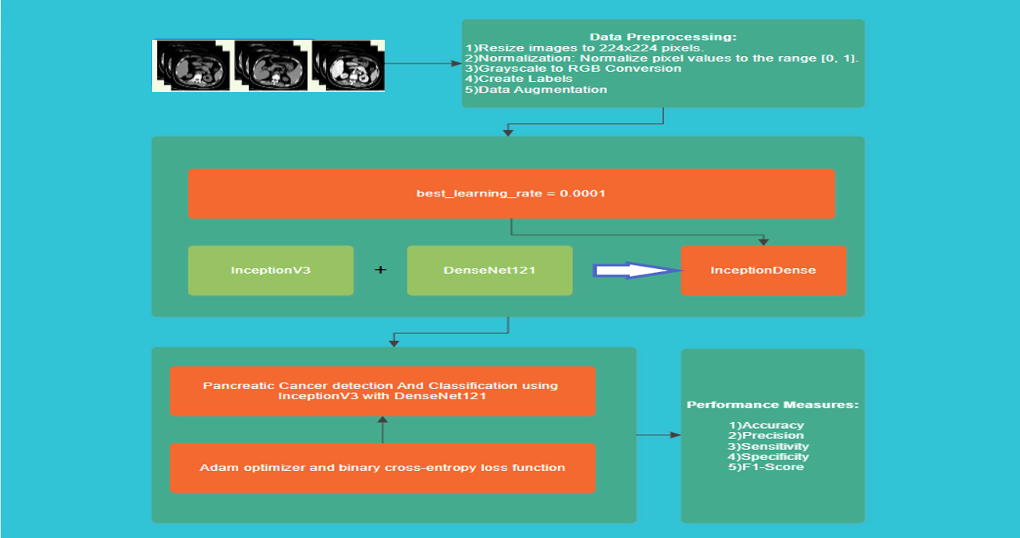
BLOCK DIAGRAM OR FLOW DIAGRAM

Slide 14
METHODOLOGY
Dataset:
1,411 annotated CT images (cancerous & non-cancerous).
Collected from medical repositories and healthcare collaborations.
Preprocessing:
Resizing: Standardized to 224x224 pixels.
Normalization: Pixel values scaled to [0,1].
Label Encoding: Binary labels (0: Non-cancerous, 1: Cancerous).
Data Augmentation: makes the model to expose to a wider range of variations in image.
Frameworks & Tools:
TensorFlow and Keras for model development.
NumPy and Matplotlib for data exploration and visualization.

Slide 15
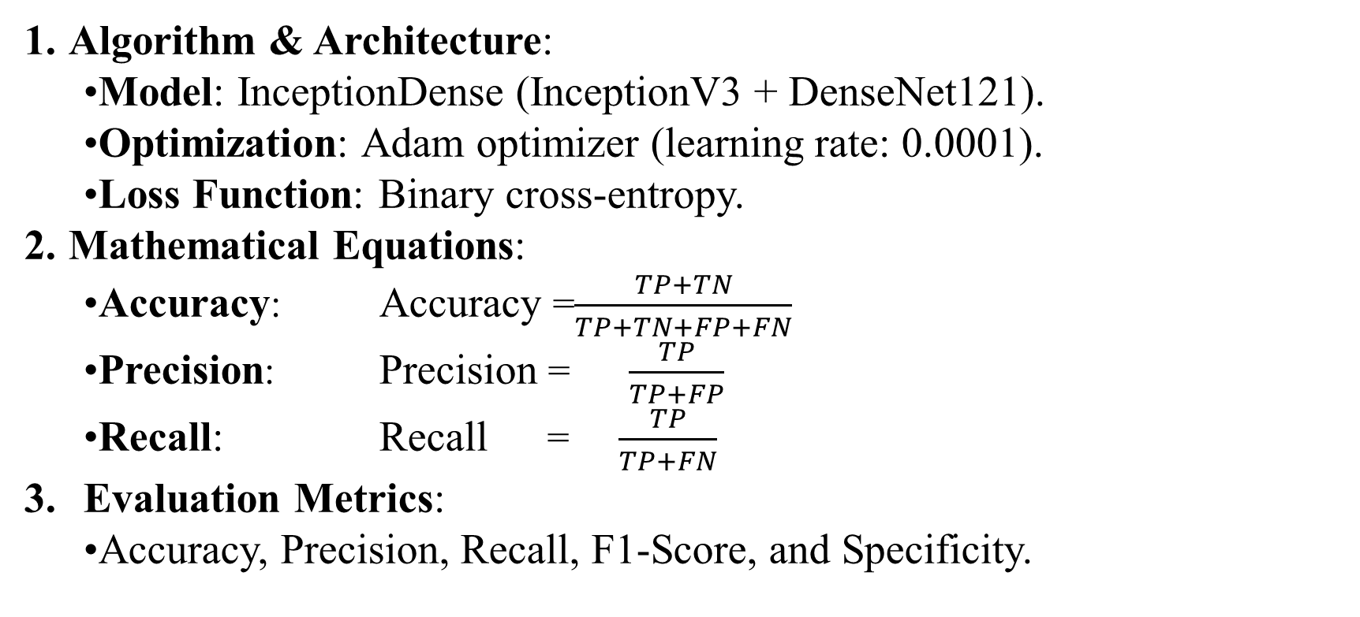
METHODOLOGY
Algorithm & Architecture:
Model: InceptionDense (InceptionV3 + DenseNet121).
Optimization: Adam optimizer (learning rate: 0.0001).
Loss Function: Binary cross-entropy.
Mathematical Equations:
Accuracy: Accuracy =$\frac{TP+TN}{TP+TN+FP+FN}$
Precision: Precision = $\frac{TP}{TP+FP}$
Recall: Recall = $\frac{TP}{TP+FN}$
Evaluation Metrics:
Accuracy, Precision, Recall, F1-Score, and Specificity.

Slide 16
RESULTS & ANALYSIS
Overview of Results
Key Metrics Achieved by InceptionDense Model:
Accuracy: 99.75%
Precision: 99.47%
Recall: 100.00%
F1 Score: 99.73%
Specificity: 99.52%
Significance:
High accuracy and recall ensure reliable cancer detection.
Precision minimizes false positives.
F1 Score and specificity balance detection efficiency and reliability.

Slide 17
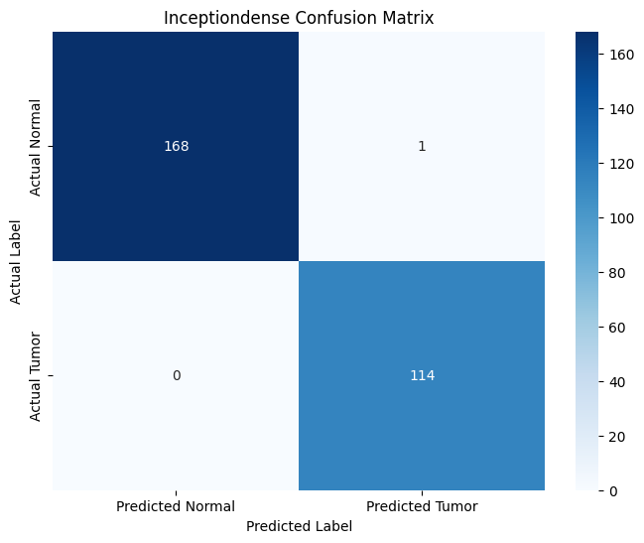
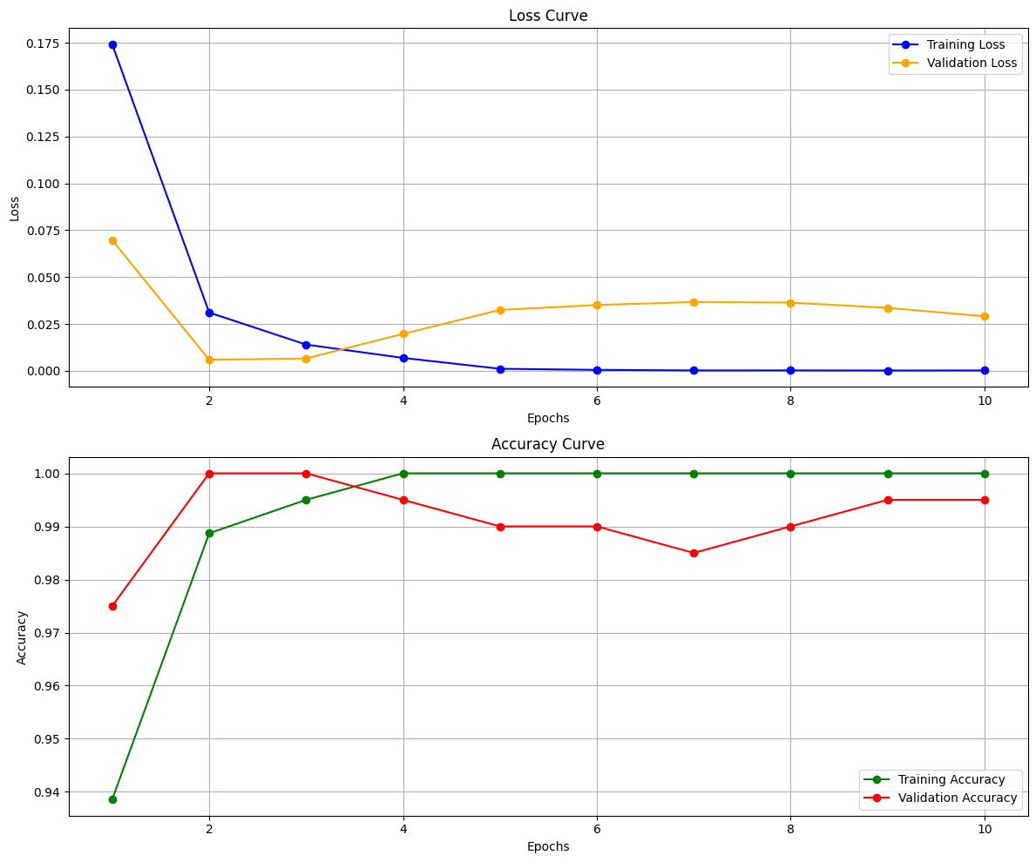
RESULTS & ANALYSIS

Slide 18
RESULTS & ANALYSIS
Model | Accuracy (%) | Precision (%) | Recall (%) | F1 Score (%) | Specificity (%)
InceptionDense | 99.75 | 99.47 | 100.00 | 99.73 | 99.52
EfficientDense | 100.00 | 100.00 | 100.00 | 100.00 | 100.00
EfficientV3 | 100.00 | 100.00 | 100.00 | 100.00 | 100.00
EfficientVGG | 99.75 | 99.47 | 100.00 | 99.73 | 99.52
ResNetV2 | 65.40 | 57.72 | 100.00 | 73.19 | 34.45
VGG16V2 | 72.98 | 100.00 | 42.78 | 59.93 | 100.00
The table highlights the performance of various deep learning models used in pancreatic cancer detection. InceptionDense achieved a strong balance across all metrics, with 99.75% accuracy and an F1 Score of 99.73%. EfficientDense and EfficientV3 demonstrated perfect scores, though the potential for overfitting is noted. EfficientVGG mirrored InceptionDense's results. Models like ResNetV2 and VGG16V2 exhibited significantly lower accuracies and imbalanced metrics, indicating the need for further optimization to handle the complexity of medical image classification.

Slide 19
CONCLUSION and FUTURE SCOPE
Key Points:
InceptionDense achieved 99.75% accuracy in pancreatic cancer detection.
Robust preprocessing and evaluation metrics ensured reliability.
Significance of Results:
High accuracy demonstrates potential for clinical use in early diagnosis.
Supports clinicians by reducing errors and improving outcomes.
Future Developments:
Validate using larger, diverse datasets.
Expand to imaging modalities like MRI and ultrasound.
Limitation:
Currently limited to CT image datasets.

Slide 20
REFERENCES
[1] J. V. N. Ramesh et al., "Sparrow Search Algorithm With Stacked Deep Learning Based Medical Image Analysis for Pancreatic Cancer Detection and Classification," in IEEE Access, vol. 11, pp. 111927-111935, 2023, doi: 10.1109/ACCESS.2023.3322376.
[2] K. V. N. Reddy, D. Reddy, P. R. Babu, A. Raman G R and B. S, "A Novel Proxy Re-Encryption Technique for Secure Data Sharing in Cloud Environ ment," 2024 International Conference on Advances in Data Engineering and Intelligent Computing Systems (ADICS), Chennai, India, 2024, pp. 1-5, doi: 10.1109/ADICS58448.2024.10533626.
[3] Y. Wang, C. Li and Z. Wang, "Advancing Precision Medicine: VAE Enhanced Predictions of Pancreatic Cancer Patient Survival in Local Hospital," in IEEE Access, vol. 12, pp. 3428-3436, 2024, doi: 10.1109/ACCESS.2023.3348810.
[4] D. Agarwal, O. Covarrubias-Zambrano, S. H. Bossmann and B. Natarajan, "Early Detection of Pancreatic Cancers Using Liquid Biopsies and Hierarchical Decision Structure," in IEEE Journal of Translational Engineering in Health and Medicine, vol. 10, pp. 1-8, 2022, Art no. 4300208, doi: 10.1109/JTEHM.2022.3186836.
[5] M. Li et al., "Computer-Aided Diagnosis and Staging of Pancreatic Cancer Based on CT Images," in IEEE Access, vol. 8, pp. 141705-141718, 2020, doi: 10.1109/ACCESS.2020.3012967.
[6] H. Ghorpade et al., "Automatic Segmentation of Pancreas and Pancreatic Tumor: A Review of a Decade of Research," in IEEE Access, vol. 11, pp. 108727-108745, 2023, doi: 10.1109/ACCESS.2023.3320570.
[7] S. N. B. Reddy, K. V. Narasimha Reddy, S. N. Tirumala Rao and K. S. M. V. Kumar, "Diabetes Prediction using Extreme Learning Machine: Application of Health Systems," 2023 5th International Conference on Smart Systems and Inven tive Technology (ICSSIT), Tirunelveli, India, 2023, pp. 993-998, doi: 10.1109/IC SSIT55814.2023.10061058.

Slide 21
REFERENCES
[8] Sireesha Moturi, S.N.Tirumala Rao, Srikanth Vemuru,Grey wolf assisted dragonfly based weighted rule generation for predicting heart disease and breast cancer, Computerized Medical Imaging and Graphics, Volume 91, 2021, 101936, ISSN 0895-6111, https://doi.org/10.1016/j.compmedimag.2021.101936.
[9] Q. Ding et al., "NIPMI: A Network Method Based on Interaction Part Mutual Information to Detect Characteristic Genes From Integrated Data on Multi-Cancers," in IEEE Access, vol. 7, pp. 135845-135854, 2019, doi: 10.1109/ACCESS.2019.2941520.
[10] C. Zhang, A. Achuthan and G. M. S. Himel, "State-of-the-Art and Challenges in Pancreatic CT Segmentation: A Systematic Review of U-Net and Its Variants," in IEEE Access, vol. 12, pp. 78726-78742, 2024, doi: 10.1109/ACCESS.2024.3392595.
[11] C. H. Crane, "Hypofractionated ablative radiotherapy for locally advanced pancreatic cancer," in Journal of Radiation Research, vol. 57, no. S1, pp. i53-i57, Aug. 2016, doi: 10.1093/jrr/rrw016.
[12] E. Kurnaz and R. Ceylan, "Pancreas Segmentation in Abdominal CT Images with U-Net Model," 2020 28th Signal Processing and Communications Applications Conference (SIU), Gaziantep, Turkey, 2020, pp. 1-4, doi: 10.1109/SIU49456.2020.9302180.
[13] M.Sireesha, S. N. TirumalaRao, Srikanth Vemuru, Optimized Feature Extraction and Hybrid Classification Model for Heart Disease and Breast Cancer Prediction International Journal of Recent Technology and Engineering Vol- 7, No 6, Mar 2019 ISSN- 2277-3878, Pages– 1754– 1772.
[14] S. L. Jagannadham, K. L. Nadh and M. Sireesha, "Brain Tumour Detection Us ing CNN," 2021 Fifth International Conference on I-SMAC (IoT in Social, Mo bile, Analytics and Cloud) (I-SMAC), Palladam, India, 2021, pp. 734-739, doi: 10.1109/I-SMAC52330.2021.9640875

Slide 22


Slide 23
ACKNOWLEGEMENTS
We express our sincere gratitude to Narasaraopeta Engineering College for providing the opportunity and resources to undertake this project. Special thanks to our guide, Dr. K.V. Narasimha Reddy, for his invaluable support and guidance throughout this research. For further inquiries, please contact us at:
Gandikota Narendra : narendragndikota2540@gmail.com
Katta Subbarao : subbaraokatta320@gmail.com
Nallabothu Narendra: nallabothunarendra0@gmail.com

Slide 24


